Slide 1
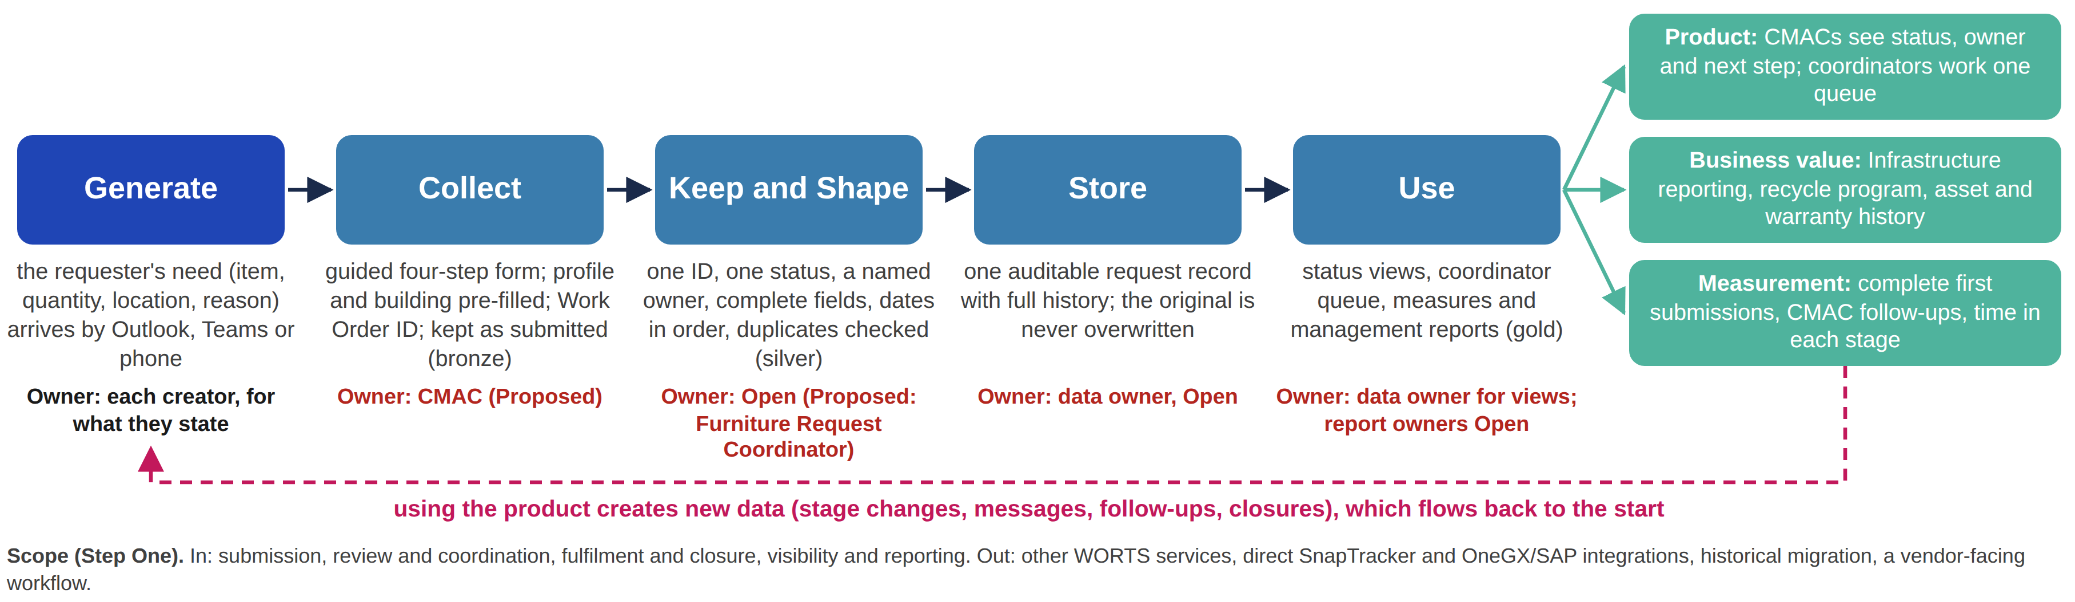
Five stages from source to sink, each with an owner
STEP TWO | THE PIPELINE END TO END
Key: bronze, the request as submitted; silver, cleaned and made consistent; gold, aggregated for reports. Red: Proposed or Open, to confirm with the client.
One request, traced through the stages: a CMAC asks for 14 additional task chairs, recycled or new, for staff on the 2nd floor of McDougall Centre (the request tested in usability Task 1). The speaker notes follow it stage by stage.
Miro board (view access for anyone with the link): https://miro.com/app/board/uXjVHidlV4o=/ | Frame: Pipeline Mapping (Ade): Source to Sink
Notes:
What the image shows
This is the pipeline model from our Miro board, built on the Session Four conceptual template. Five stages (the nodes) carry the data from source to sink, and each stage has an owner. The Use stage feeds three kinds of sink: product, measurement and business value. The dashed line is the loop: data created through use flows back to the start. The line underneath states the scope boundary from Step One. The link opens the board with view access. The frame shown is "Pipeline Mapping (Ade): Source to Sink"; the detail behind it is in the frame "Working 2: Pipeline Stages and Data Ownership".
One request, traced through the stages (the request tested in usability Task 1)
Generate: staff need 14 more task chairs on the 2nd floor of McDougall Centre. The need is born with the requester and reaches the CMAC by email, Teams or phone.
Collect: the CMAC enters it in the guided form: request type, quantity, required date, recycled or new preference, and a floor plan showing where the chairs will go. Requester and building details are pre-filled from PRISM Core. The request is kept exactly as submitted (bronze).
Keep and Shape: the coordinator checks it against the checklist. If something is missing, it goes back to the CMAC in the request thread. If it passes, it becomes one clean record (silver): one Work Order ID, one status, a named owner.
Store: every later change is added to the same record with a time and an author. Nothing is overwritten.
Use: the CMAC sees the status, the owner and the next step; the coordinator works from one queue; time in each stage is measured; reports add up recycled versus new chairs (gold).
Loop: stage changes, messages, follow-ups and closures become new data that improves the checklist and the guidance.
Controls at the hand-offs
Nodes do the work; connectors carry the data and the controls (Session Four, adapted from Raj et al., 2020). At every hand-off we ask the five questions: authentication (who may move this data), validation (is it acceptable), monitoring (would we know if the flow stopped), mitigation (what happens on failure) and alarm (who is told). Examples: only an authorized requester may submit for their ministry (FR-25); required fields and attachments are checked by request type (FR-03, FR-07); every stage change is time-stamped, so a stalled request is visible; a failed upload is retried and the user is told; an email tells the requester when action is required, which is the client's preferred channel. Controls that are not in our requirements are Proposed.
Key
Bronze, silver and gold describe how far the data has been transformed and how far it is trusted (Session Four). Bronze is the request as submitted, which is the audit trail. Silver is cleaned and made consistent, which is what the product reads. Gold is aggregated, which is what the reports read. Red marks an item that is Proposed or Open and needs the client's confirmation.

Slide 2
Every stage has an owner; two owners are still open
STEP TWO | OWNERS, PREPARATION AND CONSTRAINTS
Stage | Owner | Preparation: what it must achieve | Constraints
1 Generate | Each creator, for what they state: requester, CMAC, coordinators, vendor or mover | None: the data is created here, so it must be captured where the work happens | Intermittent, one request at a time; born in email, Teams, phone and hand-drawn floor plans
2 Collect | CMAC for the details submitted (Proposed); PRISM Core owner for pre-filled data (Open) | Guided form: required fields and attachments set by request type; requester and building pre-filled; original kept as submitted (bronze) | Event-driven; files up to 10MB, replies up to 5MB; email, Teams and phone updates are lost unless re-entered
3 Keep and Shape | Open. Proposed: Furniture Request Coordinator | Check, then shape one consistent, trusted record (silver) using the six rules on the right | No agreed match key for duplicates; the prototype shows conflicting status labels
4 Store | Data owner: Open, to confirm with the client | One shared request record; every change time-stamped and attributed; the original never overwritten | Role-based access; retention per the Government of Alberta records schedule, to confirm; no historical migration
5 Use | Data owner for what the views show; report owners Open | Product views read silver; management reports read gold (aggregated) | Proposed: a CMAC sees only their own requests; report frequency to confirm
What “clean” means here
One Work Order ID, with every update linked to it
One status from a standard list
A named, valid owner at every stage
Required fields complete before review
Dates in one format and in true order
Duplicates checked on an agreed match key
If a request fails, it goes back to the CMAC in the request thread and is checked again.
Clean is a product decision, not a technical one (Session Three). The method is not specified.
Red: Proposed or Open, to confirm with the client. Detail by stage, governance and data lineage: Miro frame “Working 2: Pipeline Stages and Data Ownership”.
Notes:
Step Two asks three things of each stage: who or what is responsible, what the preparation step must achieve, and the constraints (quality, frequency, format, ownership and access). The technical method is not assessed, so we state what clean must achieve, not how it is engineered.
Owners
Every node has an owner (Session Four). We separate who enters the data from who is accountable for its accuracy. Creators answer for what they state; the stage owner answers for the rules that make the data trustworthy; the data owner answers for the record end to end.
Generate: each creator, for what they state: the requester (the need), the CMAC (the request), the Furniture Request Coordinator (the review), the Furniture Coordinator (the assignment and the proposal), and the vendor or mover (delivery).
Collect: the CMAC, for the details submitted (Proposed). Requester and building details come from PRISM Core; the owner of that reference data is Open.
Keep and Shape: Open. We propose the Furniture Request Coordinator, who decides whether a request is complete enough to act on.
Store: the data owner is Open, to confirm with the client.
Use: CMACs, coordinators and Infrastructure management read the data. The data owner answers for what the views show; the owner of each report is Open.
What clean means
Clean is a product decision (Session Three). The six rules on the slide define a trusted record. The original is kept as submitted, so a later question can always go back to it. The client confirmed on 7 October that the checklist is meant to act as validation of what a request requires. Evidence that the rules are needed: the prototype shows one request as both "Awaiting initial review" and "Reviewing", and activity dated before submission. A request that fails the checks goes back to the CMAC in the request thread and is checked again.
Constraints
Quality: there is no agreed match key for duplicates yet, and status labels conflict.
Frequency: human-generated and intermittent; event-driven, one request at a time.
Format: needs arrive by email, Teams, phone and hand-drawn floor plans. Files are limited to 10MB and replies to 5MB. Floor plans sit in another service and are not open to CMACs (client, 7 October).
Access: role-based on every view (FR-25, NFR-14 to NFR-16). That a CMAC sees only their own requests is Proposed until the client confirms the exact permissions.
Retention: per the Government of Alberta records schedule (NFR-17), to confirm. There is no historical migration and no direct SnapTracker or OneGX/SAP link.
Open items to confirm with the client: the owners of Keep and Shape and of Store; the owner of PRISM Core reference data; the duplicate match key; the exact CMAC permissions.

